Slide 1

Large scale analysis and modeling group
http://mgroup.ntua.gr

Slide 2
Testing
Test each individual method to eliminate bugs in complex programs
Especially in parallel programming, it is easier to make mistakes and much harder to debug
Setting up automatic tests requires some work upfront but saves countless hours of debugging.
Automatic tests are necessary when altering or extending existing code. Tests make sure that we have not introduced bug in existing code, which may be
Old, probably forgotten
Unknown code written by a coworker

Slide 3
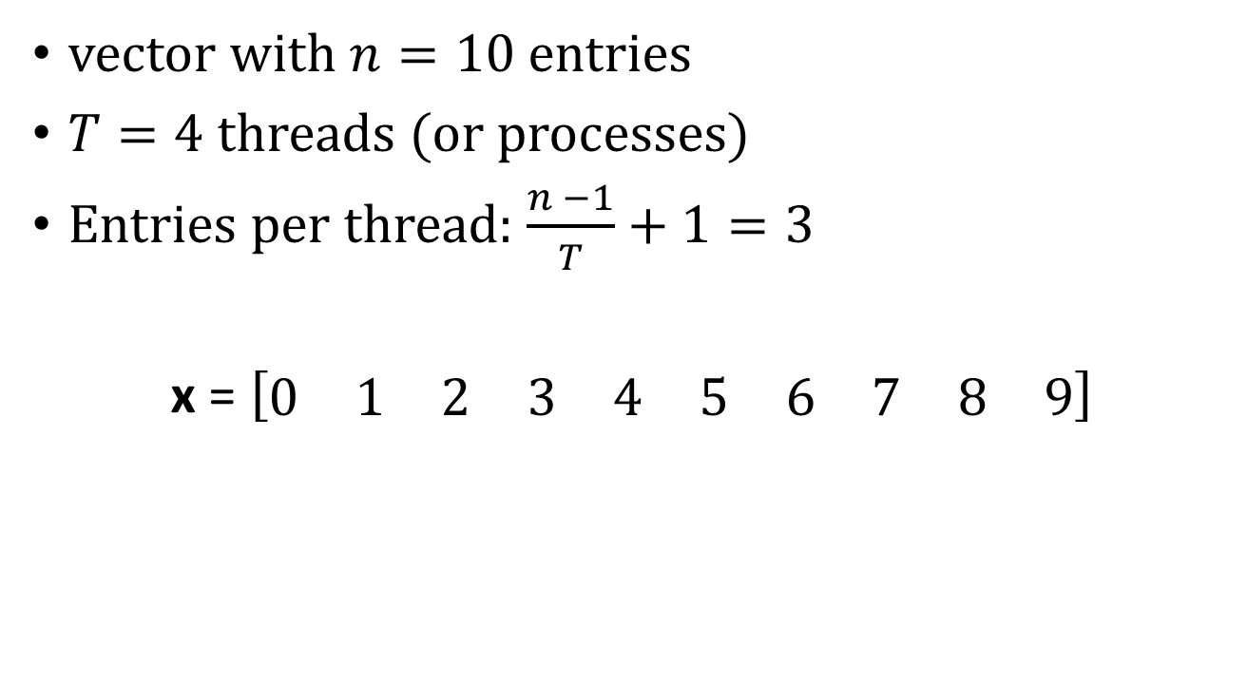
Vector partition
vector with $n=10$ entries
$T=4$ threads (or processes)
Entries per thread: $\frac{n −1}{T}+1=3$
x = $\left[\begin{matrix}0 & 1 & 2 & 3 & 4 & 5 & 6 & 7 & 8 & 9\end{matrix}\right]$
t=0
t=1
t=2
t=3

Slide 4

Vector addition
$$\left[\begin{matrix}x0 \\ x1 \\ x2 \\ x3 \\ x4 \\ x5 \\ x6\end{matrix}\right]+\left[\begin{matrix}y0 \\ y1 \\ y2 \\ y3 \\ y4 \\ y5 \\ y6\end{matrix}\right]=\left[\begin{matrix}z0 \\ z1 \\ z2 \\ z3 \\ z4 \\ z5 \\ z6\end{matrix}\right]$$
t=0
t=1
t=2

Slide 5

Vector dot product
$$x^{T}⋅y=\sum_{i=1}^{n}{x_{i}∗y_{i}}$$
Step 1 (parallel):
$${\left[\begin{matrix}x0 \\ x1 \\ x2 \\ x3 \\ x4 \\ x5 \\ x6\end{matrix}\right]}^{T}⋅\left[\begin{matrix}y0 \\ y1 \\ y2 \\ y3 \\ y4 \\ y5 \\ y6\end{matrix}\right] \left[\begin{matrix}z0 \\ z1 \\ z2\end{matrix}\right]= \left[\begin{matrix}x0∗y0+x1∗y1+x2∗y2 \\ x3∗y3+x4∗y4+x5∗y5 \\ x6∗y6\end{matrix}\right]$$
Step 2 (serial): $\left[\begin{matrix}z0 \\ z1 \\ z2\end{matrix}\right]$ $x^{T}⋅y=z0+z1+z2$

Slide 6

Striped matrix * vector
$\left[\begin{matrix}A00 & A01 & A02 & A03 & A04 & A05 & A06 \\ A10 & A11 & A12 & A13 & A14 & A15 & A16 \\ A20 & A21 & A22 & A23 & A24 & A25 & A26 \\ A30 & A31 & A32 & A33 & A34 & A35 & A36 \\ A40 & A41 & A42 & A43 & A44 & A45 & A46 \\ A50 & A51 & A52 & A53 & A54 & A55 & A56 \\ A60 & A61 & A63 & A63 & A64 & A65 & A66\end{matrix}\right]∗\left[\begin{matrix}x0 \\ x1 \\ x2 \\ x3 \\ x4 \\ x5 \\ x6\end{matrix}\right]=\left[\begin{matrix}b0 \\ b1 \\ b2 \\ b3 \\ b4 \\ b5 \\ b6\end{matrix}\right]$
t=0
t=1
t=2
All threads read the
whole vector x

Slide 7
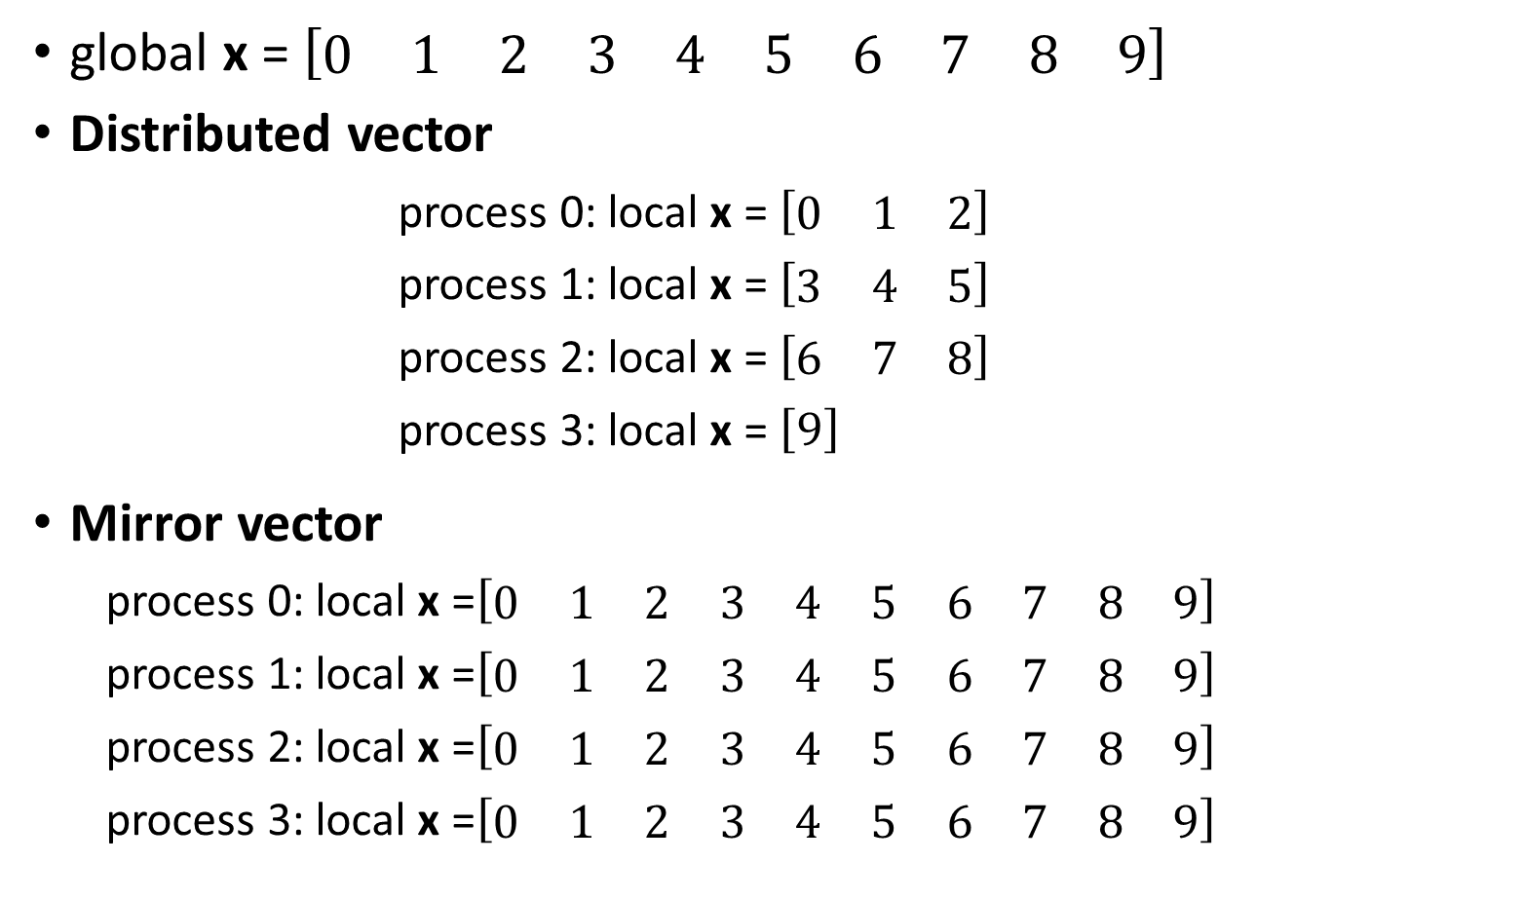
Distributed memory vectors
global x = $\left[\begin{matrix}0 & 1 & 2 & 3 & 4 & 5 & 6 & 7 & 8 & 9\end{matrix}\right]$
Distributed vector
process 0: local x = $\left[\begin{matrix}0 & 1 & 2\end{matrix}\right]$
process 1: local x = $\left[\begin{matrix}3 & 4 & 5\end{matrix}\right]$
process 2: local x = $\left[\begin{matrix}6 & 7 & 8\end{matrix}\right]$
process 3: local x = $\left[9\right]$
Mirror vector
process 0: local x =$\left[\begin{matrix}0 & 1 & 2 & 3 & 4 & 5 & 6 & 7 & 8 & 9\end{matrix}\right]$
process 1: local x =$\left[\begin{matrix}0 & 1 & 2 & 3 & 4 & 5 & 6 & 7 & 8 & 9\end{matrix}\right]$
process 2: local x =$\left[\begin{matrix}0 & 1 & 2 & 3 & 4 & 5 & 6 & 7 & 8 & 9\end{matrix}\right]$
process 3: local x =$\left[\begin{matrix}0 & 1 & 2 & 3 & 4 & 5 & 6 & 7 & 8 & 9\end{matrix}\right]$

Slide 8
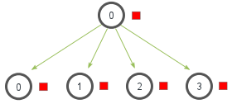
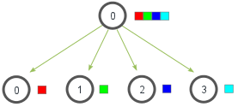
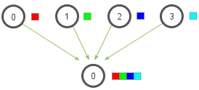
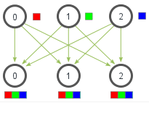
MPI collective routines
Broadcast
Scatter
Gather
Allgather

Slide 9
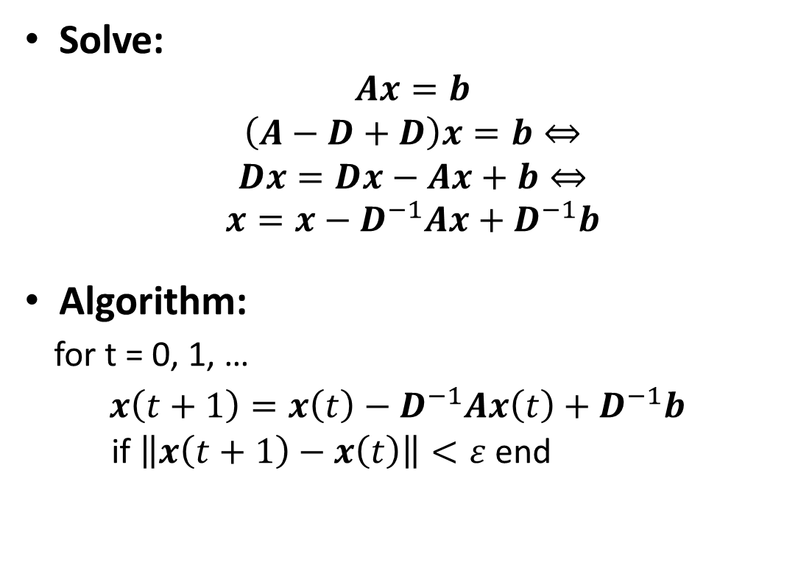
Jacobi algorithm
Solve:
$$Ax=b$$
$$\left(A−D+D\right)x=b⇔$$
$$Dx=Dx−Ax+b⇔$$
$$x={x−D}^{−1}Ax+D^{−1}b$$
Algorithm:
for t = 0, 1, …
$x\left(t+1\right)={x\left(t\right)−D}^{−1}Ax\left(t\right)+D^{−1}b$
if $\left\|x\left(t+1\right)−x\left(t\right)\right\|<ε$ end

Slide 10
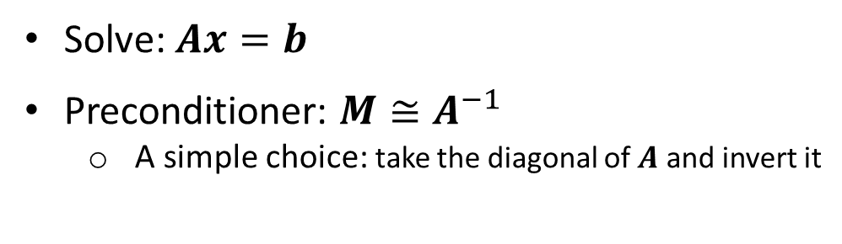
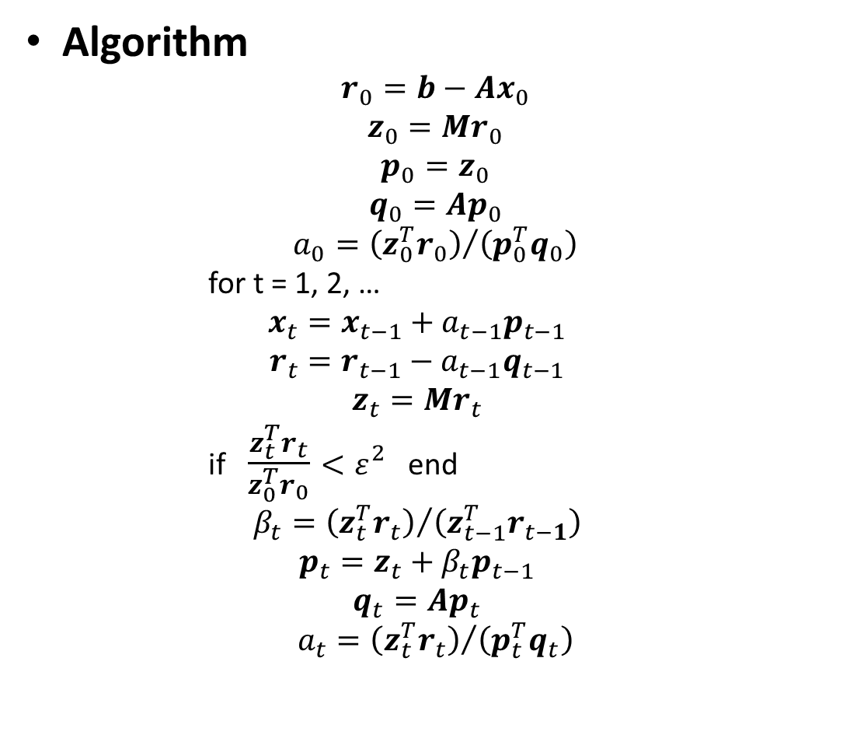
Preconditioned Conjugate Gradient
Algorithm
$$r_{0}=b−Ax_{0}$$
$$z_{0}=Mr_{0}$$
$$p_{0}=z_{0}$$
$$q_{0}=Ap_{0}$$
$$a_{0}={\left(z_{0}^{T}r_{0}\right)}/{\left(p_{0}^{T}q_{0}\right)}$$
for t = 1, 2, …
$$x_{t}=x_{t−1}+a_{t−1}p_{t−1}$$
$$r_{t}=r_{t−1}−a_{t−1}q_{t−1}$$
$$z_{t}=Mr_{t}$$
if $\frac{z_{t}^{T}r_{t}}{z_{0}^{T}r_{0}}<ε^{2}$ end
$$β_{t}={\left(z_{t}^{T}r_{t}\right)}/{\left(z_{t−1}^{T}r_{t−1}\right)}$$
$$p_{t}=z_{t}+β_{t}p_{t−1}$$
$$q_{t}=Ap_{t}$$
$$a_{t}={\left(z_{t}^{T}r_{t}\right)}/{\left(p_{t}^{T}q_{t}\right)}$$
Solve: $Ax=b$
Preconditioner: $M≅A^{−1}$
A simple choice: take the diagonal of $A$ and invert it

Slide 11
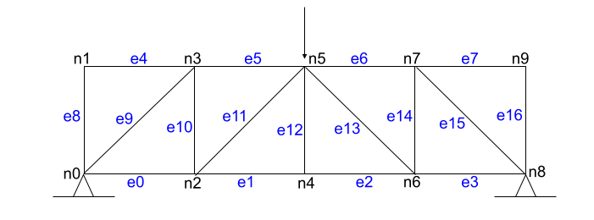
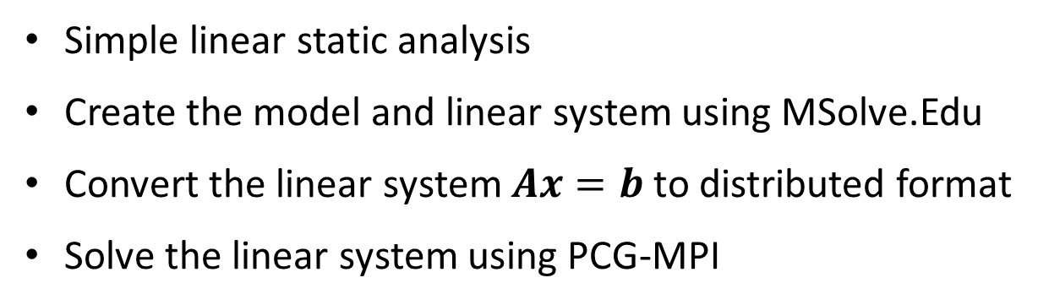
FEM example: truss structure
Simple linear static analysis
Create the model and linear system using MSolve.Edu
Convert the linear system $Ax=b$ to distributed format
Solve the linear system using PCG-MPI

